Slide 1


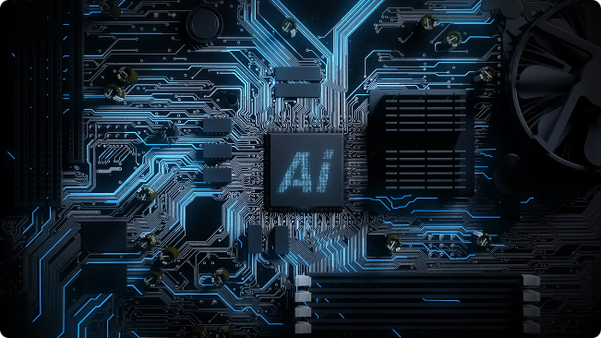

Neuromorphic Computing for AI: A Deep Dive into Hopfield Networks
Neuromorphic computing, inspired by the human brain, aims to build energy-efficient, powerful AI systems. Hopfield Networks, a type of recurrent neural network, offer a compelling solution for specific AI tasks by leveraging their unique properties. This presentation explores the fundamentals of neuromorphic computing and its application to Hopfield networks.

Slide 2

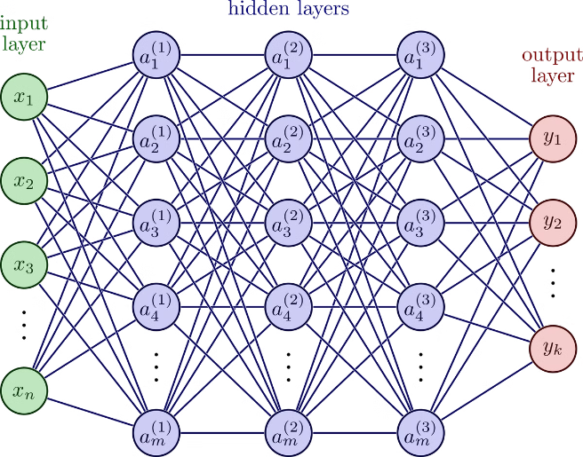
Principles of Neuromorphic Hardware Design
1
Energy Efficiency
2
Parallel Processing
Neuromorphic hardware emphasizes low power consumption by mimicking the brain's efficient signal processing.
Inspired by the brain's parallel architecture, neuromorphic chips process information simultaneously for faster computation.
3
Spiking Neurons
4
Adaptive Learning
Neuromorphic systems often utilize spiking neurons, which communicate through brief pulses of electrical activity.
Neuromorphic hardware aims to adapt and learn from new data, mirroring the brain's plasticity.

Slide 3

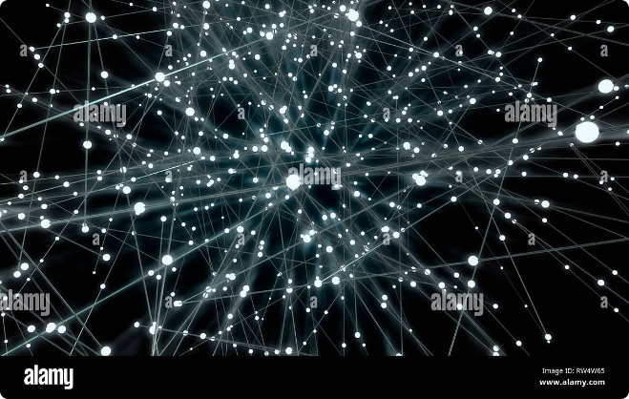
Hopfield Neural Networks: Fundamentals
Recurrent Architecture
Energy Landscape
Hopfield networks are recurrent, meaning their neurons have feedback connections, allowing them to maintain a state.
The network's state is governed by an energy function, which guides the network towards stable states.
Attractor Dynamics
Associative Memory
Hopfield networks exhibit attractor dynamics, meaning they converge to specific stable states based on input.
These networks can retrieve stored patterns based on partial or noisy inputs, showcasing their associative memory capability.

Slide 4
Advantages of Hopfield Networks for AI Applications over von Neumann Architecture
Hopfield Networks
von Neumann Architecture
Energy Efficient: Mimics brain's parallel architecture for low power consumption
Power-Hungry: Sequential processing requires high energy consumption
Parallel Processing: Processes information simultaneously for faster computation
Limited Parallelism: Processes information serially, limiting speed
Fault Tolerance: Can withstand minor errors in data or hardware
Vulnerable to Errors: Sensitive to errors in data or hardware

Slide 5

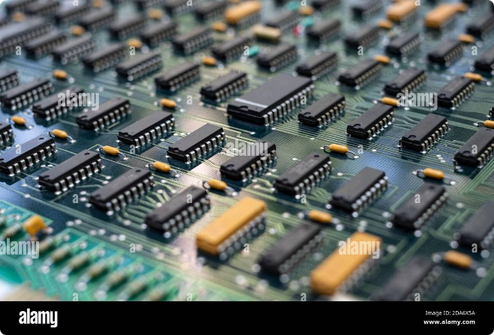
Hardware Implementation of Hopfield Networks
1
Analog Circuits
Analog circuits, often using operational amplifiers and resistors, can directly implement the Hopfield network's equations.
2
Digital Circuits
Digital implementations use logic gates and memory elements to simulate the network's dynamics.
3
Memristor Devices
Emerging memristor technology offers promise for building energy-efficient, compact Hopfield network implementations.

Slide 6


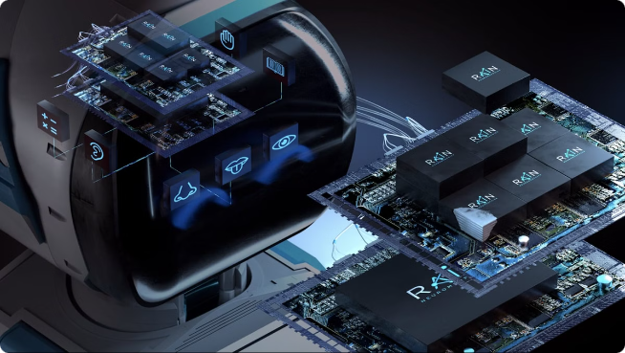


Neuromorphic Accelerators for Hopfield Networks
Specialized Processors
Neuromorphic accelerators are designed to efficiently handle the computations required by Hopfield networks.
Parallel Architecture
These accelerators leverage parallel processing to speed up Hopfield network operations.
Low Power Consumption
Neuromorphic accelerators aim to achieve low power consumption, making them suitable for mobile devices.

Slide 7
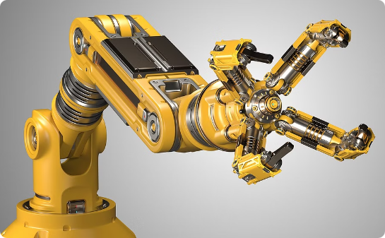

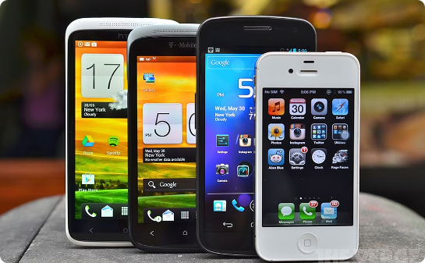
Use Cases and Applications of Neuromorphic Hopfield Networks
Robotics
Medical Imaging
Mobile Devices
Hopfield networks can be used for path planning and obstacle avoidance in robotics.
They can aid in image segmentation and analysis for medical diagnosis.
Hopfield networks can power AI tasks on mobile devices, enabling real-time image processing and pattern recognition.

Slide 8

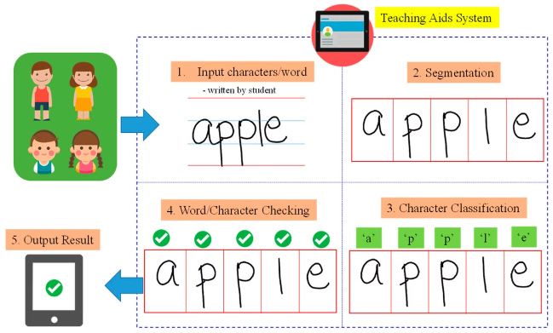
Case Study: Character Recognition
Input
Partially-written character
Hopfield Network
Learns and stores patterns for different characters
Output
Complete character based on learned patterns

Slide 9

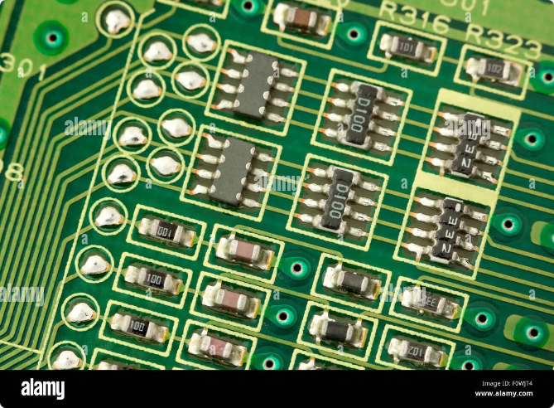



Challenges in Scaling Hopfield Networks on Neuromorphic Hardware
Scaling
Implementing large-scale Hopfield networks on neuromorphic hardware poses challenges in terms of complexity and power consumption.
Learning
Efficiently training Hopfield networks on neuromorphic hardware is an ongoing research area.
Integration
Integrating Hopfield networks with other AI components, such as deep learning models, is an area of active exploration.

Slide 10

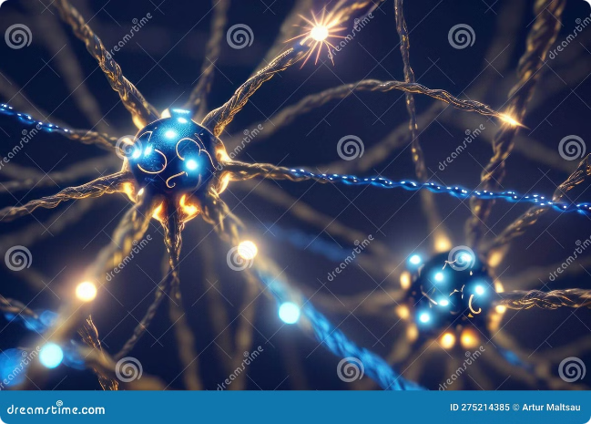
Future Directions and Research Opportunities
The future of neuromorphic Hopfield networks lies in exploring novel hardware implementations, optimizing learning algorithms, and developing applications for complex AI tasks. Ongoing research is focused on bridging the gap between the potential of Hopfield networks and the practical limitations of neuromorphic hardware.

